Slide 1
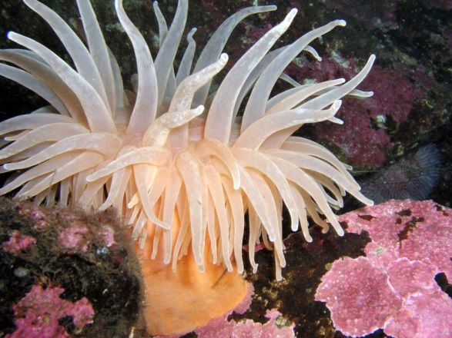
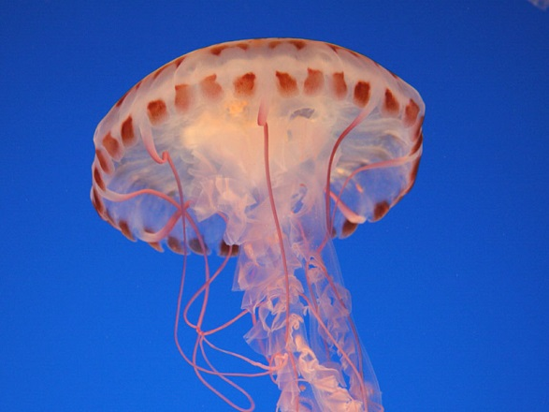
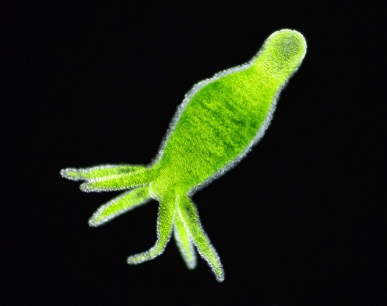
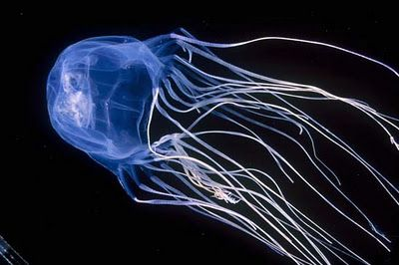
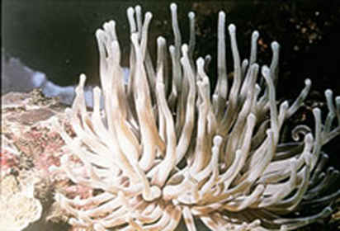
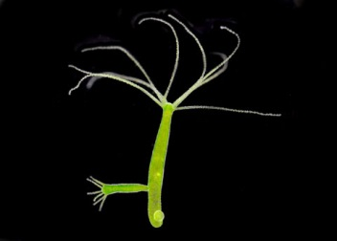
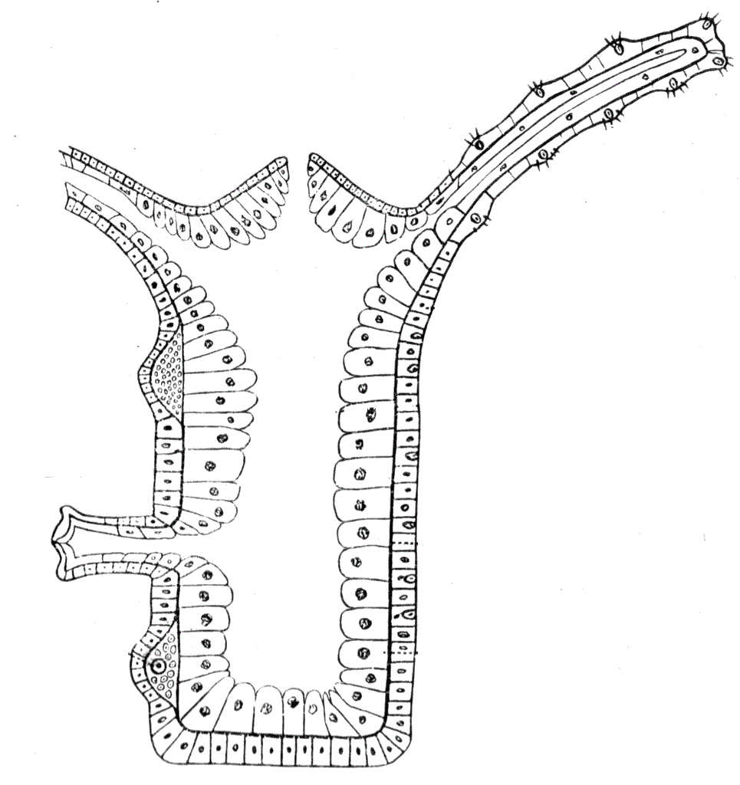
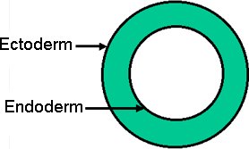
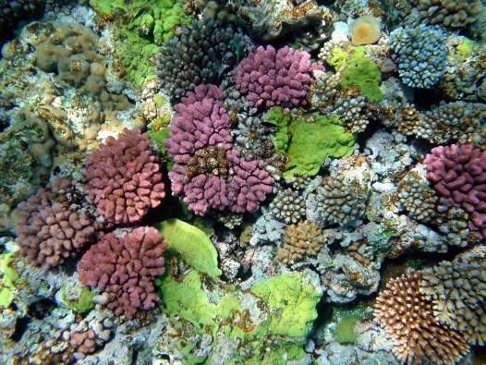
Coelenterata
These are animals living in water.
They show more body design differentiation.
There is a cavity in the body.
The body is made of two layers of cells:
One makes up cells on the outside of the body, and the other makes the inner lining of the body.
Some of these species live in colonies (corals),
While others have a solitary life–span (Hydra).
Jellyfish and sea anemones are common examples

Slide 2
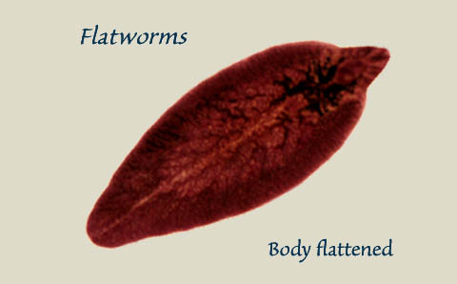
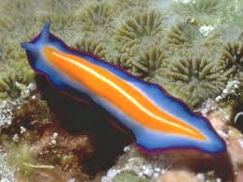
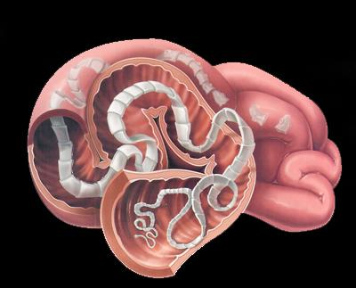
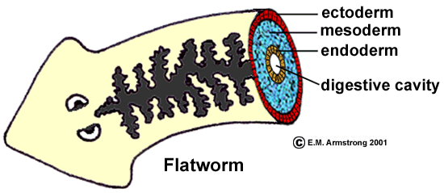

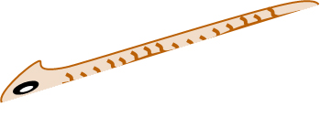
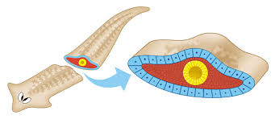
Platyhelminthes
Helminthes means worms
The body is bilaterally symmetrical, meaning that the left and the right halves of the body have the same design.
Platy means flat like plate
There are three layers of cells from which differentiated tissues can be made, which is why such animals are called triploblastic.
Having three layers
However, there is no true internal body cavity or coelom, in which well developed organs can be accommodated.
The body is flattened dorsiventrally, meaning from top to bottom, which is why these animals are called flatworms.
They are either free living or parasitic.
Some examples are free living animals like planarians, or parasitic animals like liver flukes

